Slide 2
Revision
To put word
Жұмыс іздеуші
Pros and cons
Борт серігі
To get a degree
Exaggerated expectancies
Unemployment department
Relevant topic
Сыртқы істер министрлігі
Trainee
Intern
Мемлекеттік қызмет
Job overseas
Permanent job

Slide 3
Glossary
1. job
2. gain
3. career
4.make
5. look
6. attend
7. get
8. job
9. entry-level
10. strengths and
A. experience
B. a good impression
C. to hire
D. path
E. fairs
F. weaknesses
G. an interview
H. jobs
I. ads
J. to know

Slide 4
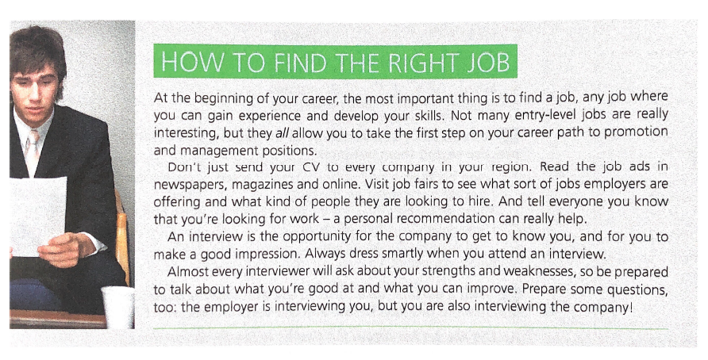
Reading

Slide 5
Complete sentences with collocations you’ve learned
I read all the ______in the newspaper and visited three ______ but I didn’t find a job.
Many companies ______ new graduates with the potential to follow a ______ to management.

Slide 6
Complete sentences with collocations you’ve learned
Almost any _____ will allow you to _____ and be promoted a better position.
As soon as I was asked to ______, I started to prepare for questions about my ______.
The first interview is to _____ candidates; if they ______, they get a second interview.

Slide 7
CV: what information do you include in your CV?
Your age
Your holiday jobs
Your interests
Your martial status
Your pets
Your photo
Your professional objective
Your religion

Slide 8
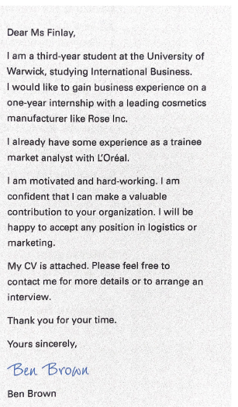
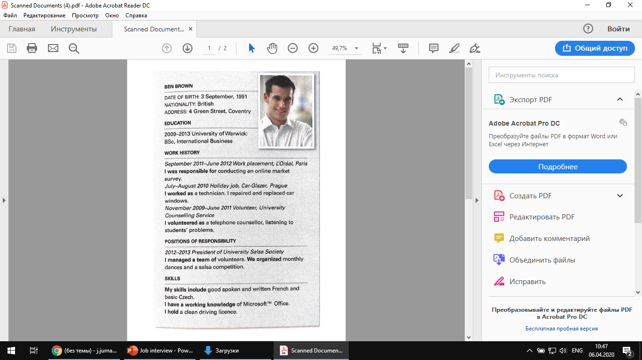

Slide 9
Home work
Fulbright
Erasmus Mundus
Bolashak
Write CV (Euro pass)
Write a Cover letter
Submit to the system till 19.04.2020 9 pm

